Slide 1

Final Project
Kyan, Kai, Edward
Notes:
Kyan

Slide 2


Team Roles
Kyan - Business Acumen / Researcher
Kai - Data Storyteller / Visualizer
Edward - Data Scientist / Modeler
Notes:
All of us

Slide 3
Problem Statement
Hypothesis
Songs released during the summer months will end up being more popular
Define “Popular”
Views
Posts
Streams
Factors
Release months and time given to become “popular”
School or Work Months
Artist
Trends
Notes:
Kyan

Slide 4
Data Overview
“Popularity”
Spotify Streams, YouTube/TikTok Views/Posts
Spotify, Youtube Music, Apple Music Playlists
Youtube/TikTok Likes
Sirius XM Spins
sp2 = sp[["Track", "Artist", "Release Date", "Spotify Streams", "Spotify Playlist Count", "Spotify Popularity", "YouTube Views", "YouTube Likes", "TikTok Posts", "TikTok Likes", "TikTok Views", "YouTube Playlist Reach", "Apple Music Playlist Count", "SiriusXM Spins"]]
Notes:
Kyan

Slide 5
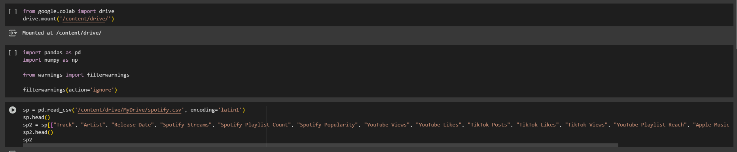
Data Overview
Sort Data
Imported drive and initialized pandas and numpy
Created a subset (sp2) with only necessary data
Notes:
edward

Slide 6
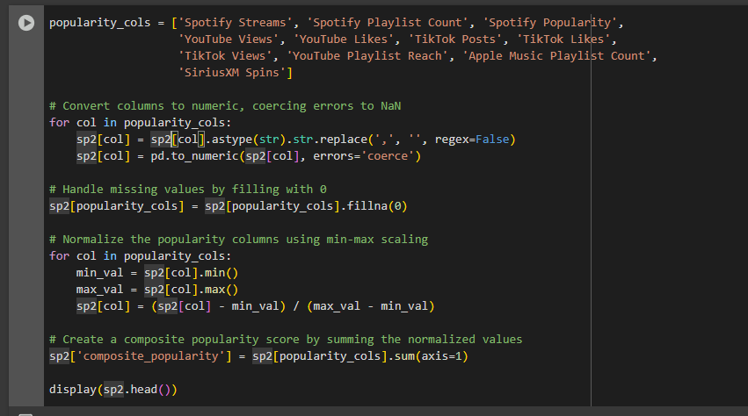
Data Overview
Defines “Popularity” with the previous columns
Converts the popularity columns to numeric values
Fills missing values as zero
Normalize popularity columns
Create a popularity score from sum of the normalized popularity values
Display the new sp2 with the popularity scores
Notes:
edward

Slide 7
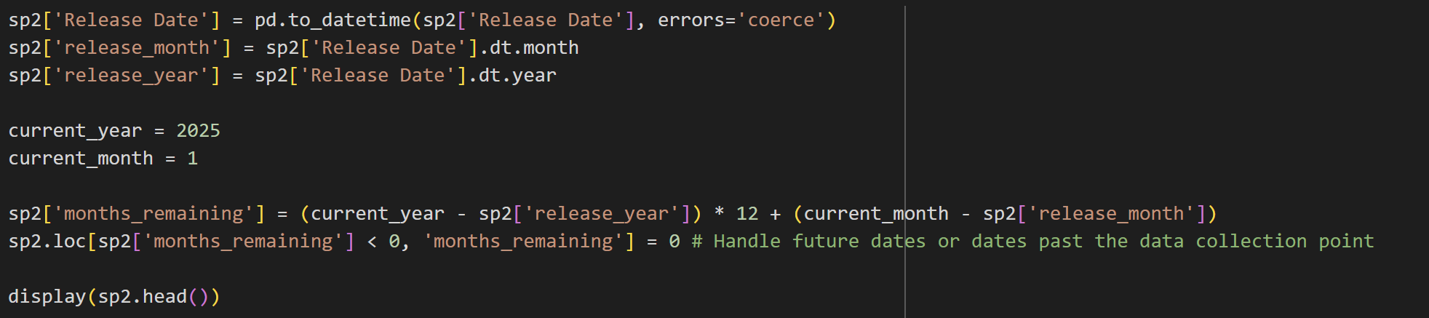
Data Overview
Setting the current year to 2025 and January to calculate songs till the end of 2024
Calculates the months remaining by subtracting the release month by the current month and adding a year to get rid of negatives
Notes:
edward

Slide 8
Data Overview
Calculates the average popularity by taking the previously “popularity” value and divide by the months remaining
Calculates the monthly “popularity” average
Notes:
edward

Slide 9
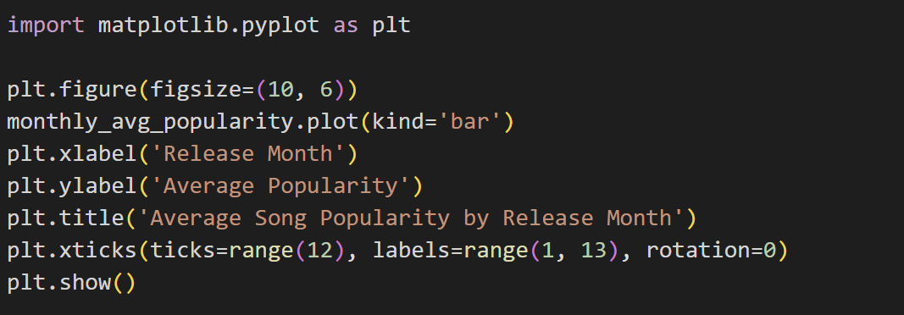
Data Overview
Imports matplotlib
Plots table by release month and the average popularity previously calculated
Notes:
edward

Slide 10
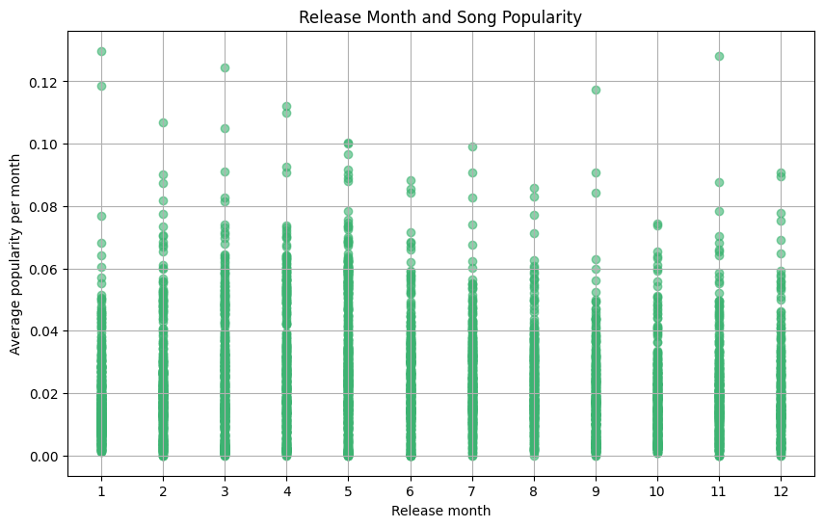
Results
Songs released in summer not popular but instead songs released right before summer are popular
Notes:
edward

Slide 11
Modeling Approach
Data Cleaning
Missing points in the data, fixing unidentified data
Engineering the features
Composite popularity is a popularity score taking into account for every column that’s popularity related from social media uses or playlists and of course, song streams
Songs released for longer would have an advantage, so data was converted into monthly form
Data Visualization
Composite popularity was graphed on scatter plots to visualize the spread of each songs popularity throughout different release months
Notes:
Kai

Slide 12
Key Insights
Release months tie into popularity because the songs are out during the more popular music listening months.
Multiple factors that affect music listening in certain months include
Exam Seasons
Vacation Months
Holiday Seasons
Notes:
Kai

Slide 13
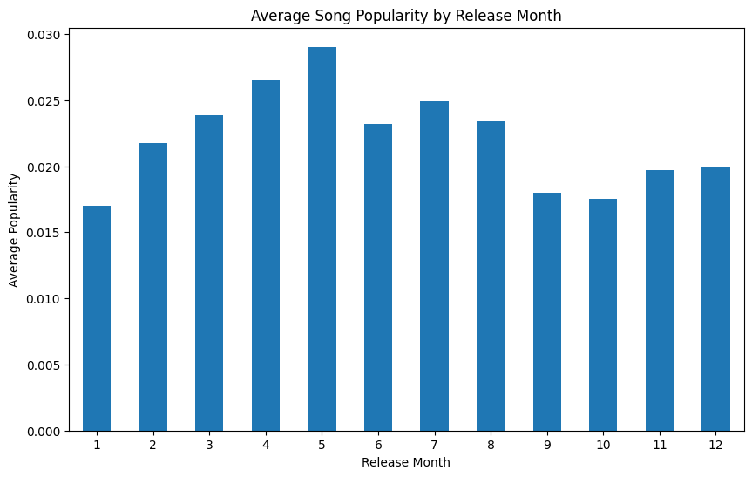
Key Insights
Averaged the popularity scores by release month
Gradual rise in popularity from January to May
Sharp Drops in popularity in both June and September
Notes:
Kai

Slide 14
Ethical Considerations and Limitations
Imputation Bias
Our missing data was auto filled to 0
Selection bias
Measuring “popularity” only from Spotify records
Third party statistics
Notes:
Kyan
Imputation bias- autofilled missing data to 0 which partially skewed our data

Slide 15
Key Takeaways
Our Hypothesis was slightly off. The most “popular” songs came out right before summer
We looked at data other than just spotify numbers (Youtube, TikTok, etc.)so our data could be more accurate
Notes:
kyan

Slide 16
THANK YOU
Notes:
Kyan

